Slide 1

Ch. 3 Plan Products & Services
3.1 The Product
3.2 Product Planning
3.3 Product Life Cycles
3.4 Effective Services

Slide 2
3.1 The Product

Slide 3
What is a product?
A product or service is usually the focus of exchange activities between customers and business.
It is the marketing mix element that most businesses consider first when planning their marketing strategy.
It is also the first consideration for consumers as they determine what they plan to purchase.

Slide 4
Business & Consumer
View of Products

Slide 5
Businesses tend to focus on the physical characteristics of the products they sell.
They use people and resources to produce products.
They want to produce a good product that will be competitive and result in a profit when sold.
They are concerned about
  how their products differ from the products of competitors,
  how they can improve their product,
  or how to produce it more efficiently.

Slide 6
Customers are most concerned about their wants and needs.
They view products as solutions.
Ex. A movie provides entertainment.
A customer is seldom concerned about how the product is produced or whether the seller will make a profit.
A product is anything offered to a market by the business to satisfy needs.

Slide 7
Product Decisions
Some customer needs are obvious and easy to identify, while others are difficult for businesses to recognize.
Because of the variety of customer needs, the uses for products, and the number of competing companies producing and selling products, companies must plan products carefully.
If companies produce the wrong products in the wrong quantities without the features and services customers need, they will have invested a great deal of time and money with no chance to sell the products at a profit.
They will quickly lose out to competitors who make better product decisions.

Slide 8
Product planning for a business
Which customers to serve, determining customer needs and developing a satisfying product for that market.
Because many companies compete to sell their products to the same customers, they will need to offer a product that is different from and better than other choices available to the customer.
The product will need to be affordable and available at a time and location convenient for the customer.
The product should be accompanied by information that will help the customer understand why the product is the best choice.

Slide 9
Levels of Products
Basic product
Enhanced product
Extended product

Slide 10
Basic Product
The physical product in its simplest form.
The basic product of one company will usually be very much like that of its competitors.
It must clearly meet a customer need.
For example: A tennis racket.
  Many companies produce and sell them.
  It is obvious what the product is and what it is used for.

Slide 11
Enhanced Products
Developed to make their products different from competitors’ products and to meet specific needs of consumers.
Adds features and options to the basic product.
Tennis Racket Example
  It can be constructed of different materials, sizes, and weights.
  It may be strung or unstrung and offer choices of grips.

Slide 12
Extended Product
Additional features that are not part of the physical product but increase its usability.
Examples are customer service, guarantees, and information on effective use, and additional products that improve the use of the product.
The choices allow customers to get just the right products to meet specialized needs.
Tennis racquet example
  People may need bags, balls, wristbands or instructional videos

Slide 13
Check Point, pg. 64
What are the levels of product a company considers when planning a new product?

Slide 14
Come up with a product that offers all three of the below:
Basic Product
Enhanced Product
Extended Product
      List next to each above

Slide 15
Components of the Product
Decisions about what to offer customers will potentially differ each time product planning decisions are made.
  In some cases consumers in the target market want just the basic product.
  At other times they want a number of product features, services, and product support in using the product.

Slide 16
Basic Product
First factor considered in deciding whether or not to purchase. If the basic product is not viewed as need satisfying, the consumer will not consider it as a reasonable alternative.
Services can also be the basic product in a marketing mix.
  Hair stylists, catering services & accounting businesses all offer basic service.

Slide 17
Features
After the basic product or service is identified, businesses can add features.
Most basic products are sold with a number of additional features.
Features are added to improve the basic product.
  Consider all of the possible features on a product as simple as a wristwatch…

Slide 18
Packaging
The primary purpose of packaging is to provide protection & security for the product during distribution.
The package can provide information about the product.
Used to promote the product through the use of color, shape, images, and information.
It can even make the product more useful for the consumer as with children’s drink boxes.

Slide 19
Support Services
Customers will want to purchase support services if they are concerned they will be unable to assemble or operate a product or if they will want assistance in its use.
If you purchase a computer, cellular telephone or home entertainment system the salesperson will try to sell you a maintenance contract.
  A support service that will pay for repair work if the product fails to operate properly.
Many times the services provided with a product make the product easier to use.

Slide 20
Brand Image
Brand – a name, symbol, word, or design that identifies a product, service or company.
A brand is very important to a company because it provides a unique identification for it and its offerings.
One of the main reasons for brand loyalty is the image of the brand.
The brands image is a unique, memorable quality of a brand.
Some brands have an image of quality, others of low price, and others as innovation.

Slide 21
Increase in Product Value
When customers purchase products or services they want to receive a good value.
If the product is poorly constructed, will not work properly, or may wear out quickly, consumers may be unwilling to purchase it.
Companies offer guarantees or warranties as insurance that the product will be repaired or replaced if there are problems.
  If a customer thinks a company will stand behind its products, they are more likely to purchase from that company.

Slide 22
Another way to add value is to increase the number of ways a product can be used.
A classic example of expanding markets through new product uses is baking soda.
Very few consumers bake their own bread today, so a baking soda manufacturer saw sales declining.
They conducted a consumer behavior study & found that consumers use baking soda for many other purposes.
  Freshen refrigerators, garbage disposals, litter boxes, & brush teeth
  Through promoting those and other uses the company increased its sales dramatically

Slide 23
Check Point, pg. 65
What are the components of the product mix element?

Slide 24
Lesson 3.1 Questions, pg. 66
Checkpoint Questions pg. 64
Checkpoint Question pg. 65
Think Critically page 66 (1 – 4)

Slide 25
Lesson 3.2
Product Planning
Marketing
Mrs. Ellsworth

Slide 26
The Product Planning Function
How do products get developed?
Who do you think is responsible?
Yes,
  Inventors, engineers, scientists working in labs, but others help too.

Slide 27
Product/Service Planning
One of the 7 Marketing Functions, pg. 5
  Product/Service Management
  Distribution
  Selling
  Marketing-Information Management
  Financing
  Pricing
  Promotion

Slide 28
Product/Service Planning
Assisting in the design & development of products & services that will meet the needs of prospective customers
  Key Parts of the definition
    assisting – marketers work cooperatively with others in product development
    meet the needs – products of the company are designed to satisfy customers

Slide 29
The Role of Marketing
Marketers work in close contact with the customer every day, putting them in a good position to understand them.
Helping the marketer know:
  What they like and do not like.
  How they view competing products.
  Whether they are satisfied with current products.

Slide 30
Marketing & Product Planning
Marketers represent the consumer in the business as products are designed and developed.
There are 3 important roles for marketers in the product development process:
  Conduct research
  Develop the marketing mix
  Conduct market tests

Slide 31
Conduct Research
The MOST important role for marketing in product development is to conduct research.
Gathering marketing information, studying it and providing results to scientists, engineers and others involved in product development keeps the focus on:
  consumer needs &
  competition
  rather than perceptions of the people involved in planning.

Slide 32
Through research marketers can
Study competition
Identify target markets
Review alternative product designs and features
Analyze several product choices

Slide 33
Marketing Information System
Allows information from many sources to be collected, stored and analyzed when needed to improve new product decisions.
Sales data, salesperson & customer feedback, customer requests & complaints & other information are included in a marketing information system.

Slide 34
Develop the Marketing Mix
A new product is part of a marketing strategy developed to achieve specific objectives.
If the companies goal is to increase its share of a specific market, it might develop a different product than if the goal is to enter a market it has never competed in before.
A new company that cannot risk failure with a new product may approach product development in a very different way than an experienced and profitable company.

Slide 35
A marketing strategy combines decisions about a target market and an appropriate marketing mix.
  The product is only part of the strategy.
Marketers participate in developing an effective strategy by helping identify:
  Possible target market strengths & weaknesses.
  Evaluating market positions.
  Suggesting alternative marketing mixes.

Slide 36
Conduct Market Tests
After a product & the remaining parts of the marketing mix have been designed, marketers conduct tests to determine if the new product will be successful.
Several ways to test a new marketing mix
  Test market – a small representative part of the total market.
  Companies introduce the new product in test markets before investing in the cost of entering the entire market.
Check Point, pg. 69
  Why is it important for marketers to be involved in new product development?

Slide 37
New Product Planning
Most companies follow a very careful process to identify and develop new products.
  This is used to eliminate products that aren’t likely to be successful before the company spends too much money for production and marketing.
Also, used to make sure that the products:
  Meet an important need,
  Can be produced at a reasonable price,
  Will be competitive with other products in the market.

Slide 38
6 Steps in the New Product Development Process
Idea Development
Idea Screening
Strategy Development
Financial Analysis
Product Development and Testing
Product Introduction

Slide 39
Idea Development
It is very difficult to find ideas for products that are really new.
Developing new product ideas can be a very creative process.
Ways companies identify new product ideas:
  Brainstorming
  Creative thinking exercises
  Problem solving

Slide 40
Products are developed to meet consumer needs, so gathering information from consumers helps to generate ideas.
New product ideas may be developed from
  Problems customers are having.
  What customers don’t like about current products.
  Complaints customers make to the company.

Slide 41
Idea Screening
Carefully screen all new product ideas to select those that have the greatest chance of being successful.
Businesses ask specific questions to test ideas.
  Is there a specific market & adequate demand for the product?
  Is competition in the market favorable for the product?
  Does the company have resources to produce the product?
  Is the product legal & safe?
  Do the costs of producing and marketing the product present an opportunity for profitable sales?

Slide 42
Strategy Development
After choosing a reasonable product idea the business creates and tests a sample marketing strategy.
Research is done to clearly identify an appropriate target market and insure that customers exist with the need and money for the product.
Next, several alternative marketing mixes are analyzed to determine the possible combinations of product, distribution price, and promotion.
  Based on that study the best mix is selected.
It is possible that the research in this step will determine that an effective mix CANNOT be developed and the product idea must be DROPPED.

Slide 43
Financial Analysis
If research determines that a new product idea meets a market need and can be developed, the company will complete a detailed financial analysis.
The company will calculate:
  Costs of production and marketing.
  Sales projections for the market.
  Potential profits.
Companies use computer models to help with financial analysis.
The results of the analysis are matched against other company goals and profit objectives to determine if the product should be developed and marketed.

Slide 44
Product Development & Testing
Following this careful research and planning, the company develops their product.
For a manufacturer, that means designing the production process, obtaining the needed equipment and materials and training the production personnel.
For very expensive or very risky products the company may decide to develop a prototype (sample) of the product.
The prototype can be used to test quality and costs before moving to full-scale production.

Slide 45
Product Introduction
After the product has been developed, the company prepares for its full-scale introduction.
All of the marketing mix elements (product, price, place, promotion) must be planned and implemented.
Cooperating companies such as wholesalers, retailers, transportation companies and ad agencies need to be involved.
Production levels must be high enough to have an adequate supply of the product available to meet target market needs.
Marketing personnel need to be prepared for their responsibilities

Slide 46
All activities must be coordinated and controlled by managers.
The company needs to be very cautious when preparing for the product introduction.
It is possible that:
  Conditions will have changed.
  Competitors may have anticipated the new product.
  Consumers will not respond in exactly the way you had predicted.
Adjustments in the marketing strategy may be needed.
Check Point, pg. 71
  What are the six steps in the new product planning process?

Slide 47
Student Name
Marketing Lesson 3.2 – Questions
Checkpoint Question pg. 69
  Why is it important for marketers to be involved in new product development?
Checkpoint Question pg. 71
  What are the 6 Steps in the new product planning process?
Think Critically, pg. 72 (1 – 4)
  Why is there a greater likelihood of new product failure if marketers are not involved in the planning process?
  Why do companies continue to develop new products if there is such a high failure rate?
  Other than consumers, what are some other sources of new product ideas?
  What are advantages and disadvantages of using a test market for a new product?

Slide 48
3.2 – Making Connections Science, pg. 72
Research completed at universities and in governmental agencies has resulted in many new consumer products.
  New drugs are developed to treat illnesses and diseases.
  Improvements are made in computers and technology.
  New and improved Communications and Agricultural products are provided daily.
Use the internet to research new consumer products being provided to consumers. Choose one of the above categories to research and 5 new product developments under that category.
Once you have researched new product developments use Sway to create a presentation on the new product developments you have chosen. Be sure to use pictures.
When your Sway is completed you need to share it to Mrs. Ellsworth.

Slide 49
Category 1 - New drugs are developed to treat illnesses and diseases.
Category 2 - Improvements are made in computers and technology.
Category 3 - New and improved Communications and Agricultural products are provided daily.
Student Name _______________________
Category Chosen _____________________
Topic 1 - __________________________
Topic 2 - __________________________
Topic 3 - __________________________
Topic 4 - __________________________
Topic 5 - __________________________

Slide 50
Making Connections - Business Law
Businesses and individuals can protect new product ideas through the use of patents and copyrights.
Research the US Patent and Copyright Laws
Write a 1 page report that:
  Describes each law.
  Tell how each law provides protection.
  The process for receiving a patent and a copyright.

Slide 51
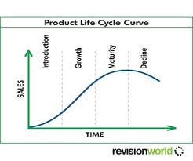
Lesson 3.3
Product Life Cycles

Slide 52
The Product Life Cycle
Successful products move through a set of predictable stages throughout their product lives.
These stages show how profits and sales change as competition increases.

Slide 53
Introduction Stage of the Product Life Cycle
The stages of sales and profit performance through which brands of a product progress as a result of competition.
A brand new product enters the market
  Growth
  Maturity
  Decline

Slide 54
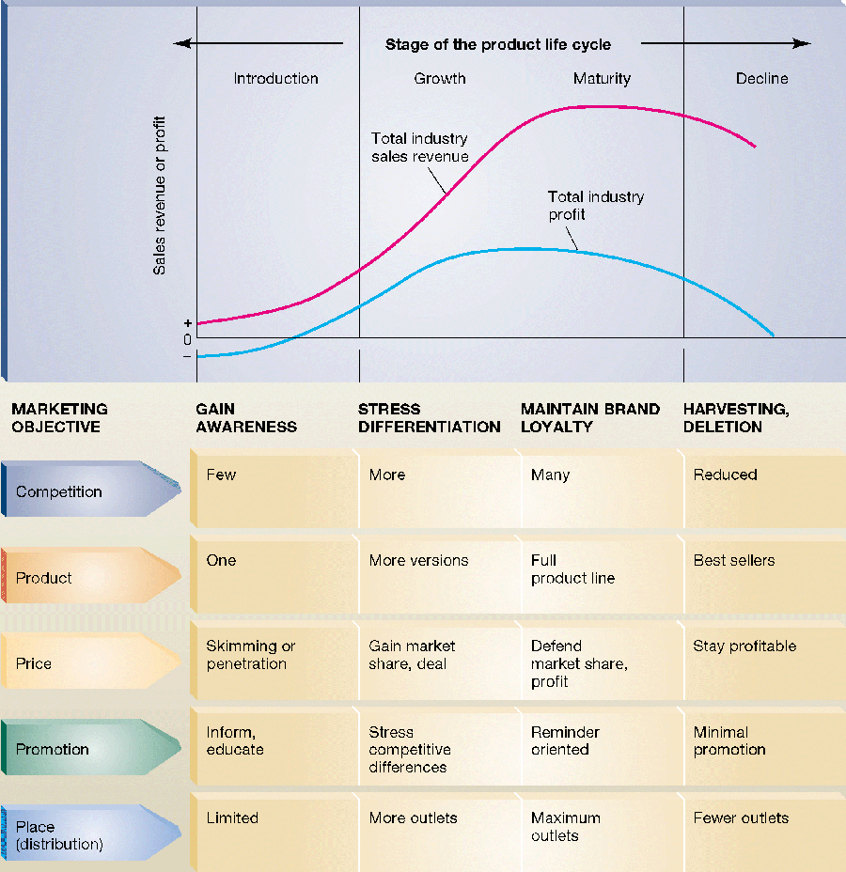

Slide 55
Introduction Stage
A brand new product enters the market.
Initially there is only one brand of the product available for the consumer to purchase.
The new product is quite different from and hopefully, better than what consumers have been using.
While every product has gone through the introduction stage.
Examples of products currently in the Introduction Stage;
  IPads, 3D TV

Slide 56
The costs of producing and marketing a new product are usually very high, resulting in a lower initial profit.
The company is counting on future sales to make a profit.
If a product is introduced successfully, an increasing number of consumers will accept the new product.
  Causing sales to grow rapidly and profits will emerge.

Slide 57
Growth Stage of the Product Life Cycle
When competitors see the success of the new product they want to get into that market.
They try to copy the new product as closely as possible and make improvements.
When several brands of a new product are available the market moves into the growth stage of the product life cycle.

Slide 58
If the customers like the new product they begin buying it regularly and telling others about it.
  The market then experiences a rapid sales growth.
As initial costs are recovered the industry experiences growth in profits.
Product Examples: mp3 players, digital cell phones

Slide 59
Maturity Stage of the Product Life Cycle
As the market for a new product moves through the growth stage, the product is purchased by many more customers and becomes very profitable.
Many companies in the market develop and sell their own brand of a successful product.
In the maturity stage the product has many competing brands with very similar features.

Slide 60
Customers have a very hard time identifying differences among brands and have much less brand loyalty.
Competition gets very intense as businesses compete for the same customers with their very similar products.
Examples; cars, computers, cereal, toothpaste, pop, etc.

Slide 61
Decline Stage of the Product Life Cycle
Many products remain in the maturity stage of the product life cycle for many years.
  Sooner or later they do fall into the decline stage.
The decline stage occurs when a new product is introduced that is much better or easier to use
  customers switch from the old to the new product.
As more customers are attracted to the new product, companies selling the old product see a decline in profits and sales.

Slide 62
The company may not be able to improve the older products enough to compete with the new products so they may drop them with their declining profits.
Examples: push lawn mowers, 3 speed bicycles
Check Point, pg 75
  How do sales and profits change in the stages of a product life cycle?

Slide 63
Marketing Across the Product Life Cycle
Marketing strategy needs to be adjusted at each stage of the product life cycle.
What may change at each stage.
  Competition
  Target Market
  Marketing Mix

Slide 64
Introduce a New Product
Be sure to inform prospective customers about the product and its uses.
Show the customer how this new product is better than the old products they already use.
Initially only a few customers will buy the new product.

Slide 65
Their experience will determine if others will want to buy it.
Distribution and promotion are major marketing activities to be used when introducing a new product.
Prices are likely to be high because the product is new.

Slide 66
Manage Product Growth
New companies enter the market in the growth stage.
Each company is trying to attract customer to its own brand.
What companies do:
  Companies try to improve their brands by adding features, options and services.
  They also add to their channels of distribution to make their product more readily available to the growing number of customers in the market.

Slide 67
Promotion emphasizes the differences among the brands and is directed to the specific target markets the company wants to satisfy.
Prices may start to decline, although customers may pay more for preferred brands or for unique features or special services.
Profits are likely to go up for a time as companies sell larger quantities of products.
Over time additional marketing costs reduce profits for many companies.

Slide 68
Move Through Maturity
There are fewer new customers in the Maturity Stage of the Product Life Cycle.
Companies increase competition to gain a greater marketing share.
Costs increase because there are so many customers and companies must distribute products across such a wide area.
Much money is spent on promotion because customers have many choices and see very few differences among brands (advantage is key).

Slide 69
They reduce prices by offering sales, coupons and rebates.
Sales may increase for a time using these methods, but profits usually fall.
A business could respond to the maturity stage by looking for new markets or by moving into international markets.

Slide 70
Avoid Decline
When a company sees sales and profits declining in the market, immediate changes must be made.
If the decline continues, it usually means that the customers no longer value the product and are looking for newer and better alternatives.
Some companies have been able to move old products out of the decline stage by finding new uses for them.
  ie. Baby oil is now used as a sun tan product
If a company cannot save a product from the decline stage they will attempt to sell their remaining inventory to the customers who still prefer it.

Slide 71
Use a Market Orientation
Companies that use a marketing orientation in the beginning are in a better position to adjust to each life cycle stage.
  Those companies study their customers.
  They recognize when customer needs are not being satisfied and how customers view competitive products.

Slide 72
Marketing oriented companies also study the economy and the competition so they can predict when competition is increasing and are more aware if a competitor is planning a new product introduction.
Check Point, pg. 76
  How does marketing in the growth state of a life cycle differ from marketing in the maturity stage?

Slide 73
Lesson 3.3 - Questions
Think Critically 1 – 4
Make Connections
  5. History
  6. Business

Slide 74

Lesson 3.4
Effective Services

Slide 75

The Emerging Service Economy
More than 2/3 of all employers in the US now work in service businesses or service jobs.
More than ½ of all purchases made by consumers today are services.
The US is changing from the world’s leading manufacturing economy into the leading service economy.

Slide 76
What are services?
Services – activities of value that do not result in the ownership of anything tangible.
Traditional service businesses – movie theatres, insurance companies, banks, etc.
New types of service businesses – Internet service providers, financial planners, etc.

Slide 77
Services have important characteristics that make them different from products and affect the way they are planned and marketed.
Services differ from products in their form, availability, quality and timing.

Slide 78
The Emerging Service Economy
Form
Availability
Quality
Timing

Slide 79
Form
Services are intangible, they do not include a physical product.
They cannot be seen or re-examined before purchased.
They do not exist after they are purchased and used.
For example:
  If you get your car washed, you will need to return for the service each time the care needs to be cleaned.

Slide 80
Availability
A service cannot be separated from the business or person supplying it.
For example
  Medical treatment requires a nurse or doctor.
  A basketball game requires two teams and coaches.
The availability and the skill of the person providing the service is very important to the customer.
You will be dissatisfied if the person providing an important service is not able or motivated to complete the job on time.
If the person cannot provide the service when you want it, you must go without or find another source.

Slide 81
Quality
The quality of the service depends on who provides it as well as on where and when that service is provided.
For example
  An accountant who is not aware of the latest tax laws may have errors in tax returns that are prepared.
  A pizza delivery service that takes too long or does not have temperature controlled delivery bags will bring cold pizza to your door.
An effective service business needs to be able to control the quality of services and insure that customers get the same quality time after time.

Slide 82
Timing
A service cannot be stored or held until the consumer needs it.
For example.
  After the movie starts in a theatre it is no longer available in its complete form until it is replayed.
  If the tables in a restaurant are filled no one can be seated at that time.

Slide 83
Check Point, pg. 79
What are the four ways in which services differ from tangible products?

Slide 84
Marketing Services
By understanding the unique characteristics of services, managers in charge of planning and marketing services can do a better job of meeting customer needs.

Slide 85
The Marketing Mix for Services
Each of the attributes of a service must be considered when developing the marketing mix.
Those attributes can be matched to each of the mix elements; product, price, place, promotion.
The company must offer an important service and make sure it is understandable to the customer.
It must distribute the service conveniently to the target market.
Promotion must effective communicate the unique qualities of the service in understandable ways.
Finally, the price must meet customers’ expectations of a good value.

Slide 86
Changes in Service Business
Successful service business are constantly searching for better ways to provide services.
Some of those with quality standards and determining ways to maintain those standards and using technology to improve the delivery and availability of services.
Ways include more careful hiring and training of employees, identifying services
For example:
  The internet is providing both opportunities and challenges for service businesses.
  It is easier to get information to customers using the internet.

Slide 87
Franchising
Franchising allows a service to be provided in a variety of locations while maintaining a consistent image and level of quality
A person buys a franchise and gets the help and expertise of the parent company in planning and managing the service business.
Sample franchises – restaurants such as McDonalds or Subway

Slide 88
Managers of service businesses are learning that marketing orientation is just as meaningful to their companies as it is to businesses that produce and sell products.
Extended hours, more locations, customized services and follow-up activities with customers to ensure satisfaction are all ways that businesses are attempting to meet customer needs.

Slide 89
Check Point, pg. 80
Why is communication so important to service businesses?

Slide 90
Lesson 3.4 - Questions
Think Critically 1 – 3
Make Connections
  4. Career Planning
  5. Research

